Slide 1


Teamwork Communication for nerds
● Jitske Habekotté ● habekotte.j@buas.nl ● BUas

Slide 2

Who am I?
Jitske Habekotté (any pronouns)
CMGT & MGT Graduate (VA)
Lecturer Master Game Technology
Own games company:
SkogsArt Studio
Spearheading Lifetime in Games

Slide 3
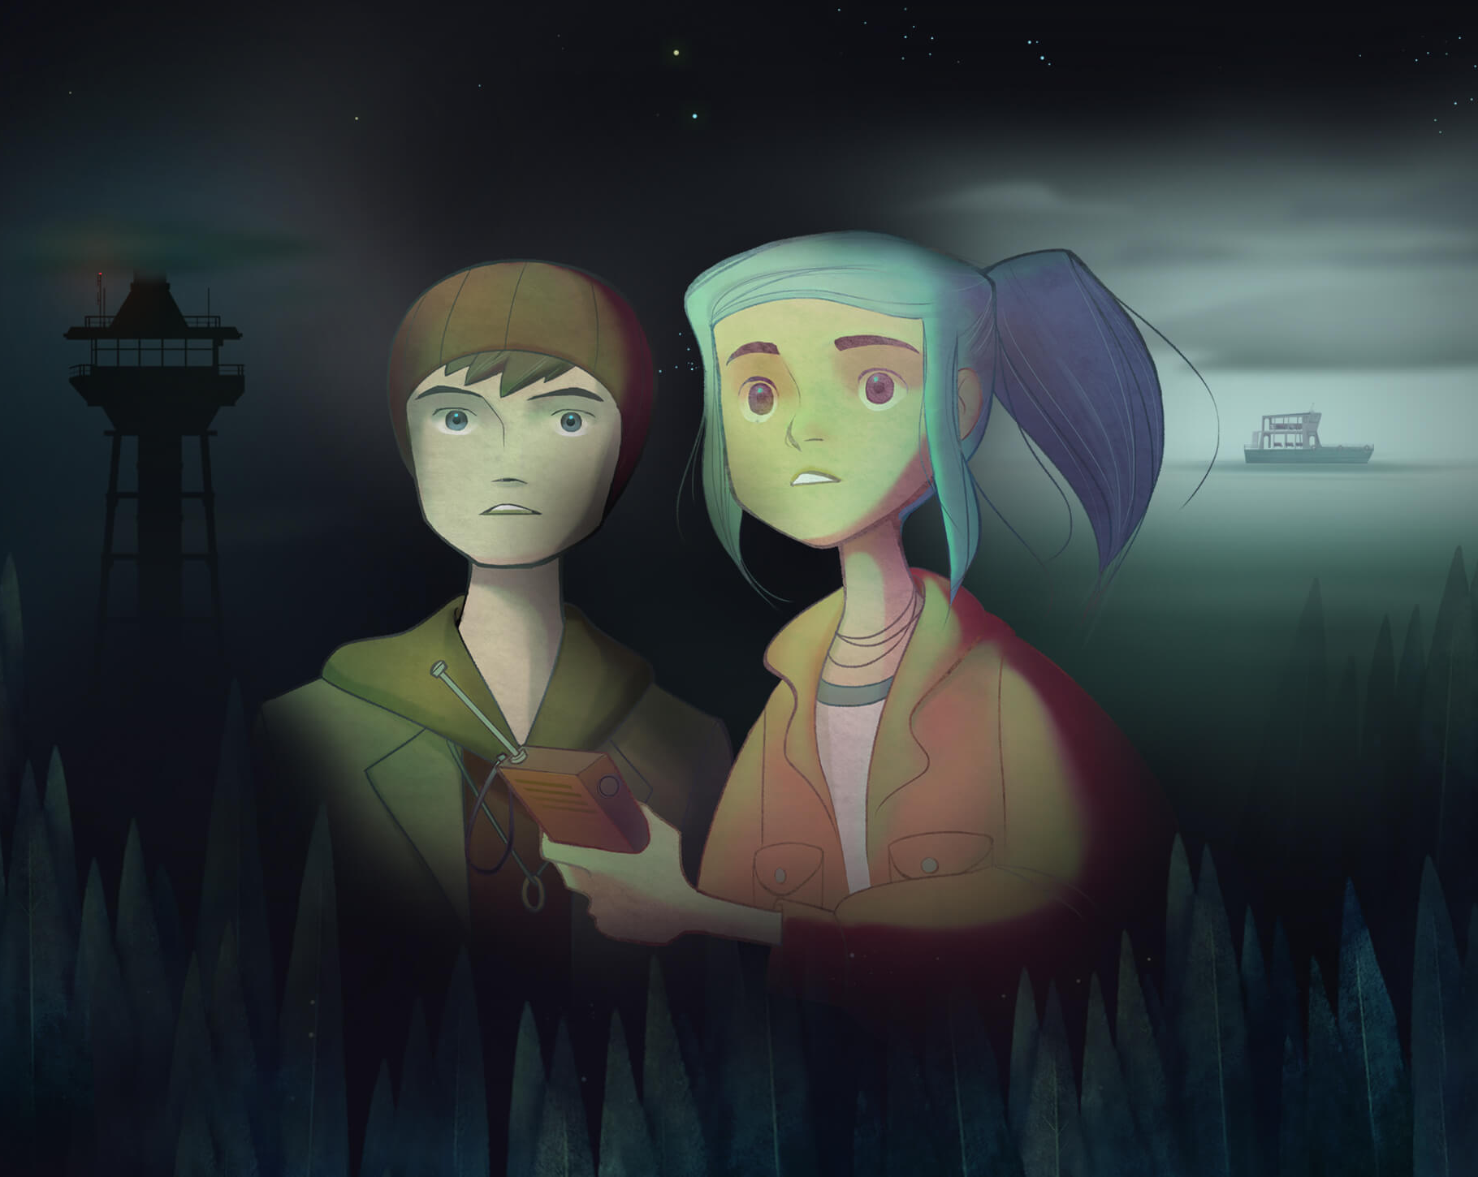
Breakdown
Leader vs Boss
Project Health
Project vision & concessions
The art of feedback
Conflict
Meetings
Documents
Take away
Questions

Slide 4

Leader vs Boss
Leader ≠ Boss
People want to be the boss
No one tells each other what to do
A good leader:
≠ the decision maker
≠ the one with the best skills
Listens
Knows strengths and weaknesses
Helps with structure and guidance (good parenting)*
Full potential
Mediates
Example

Slide 5
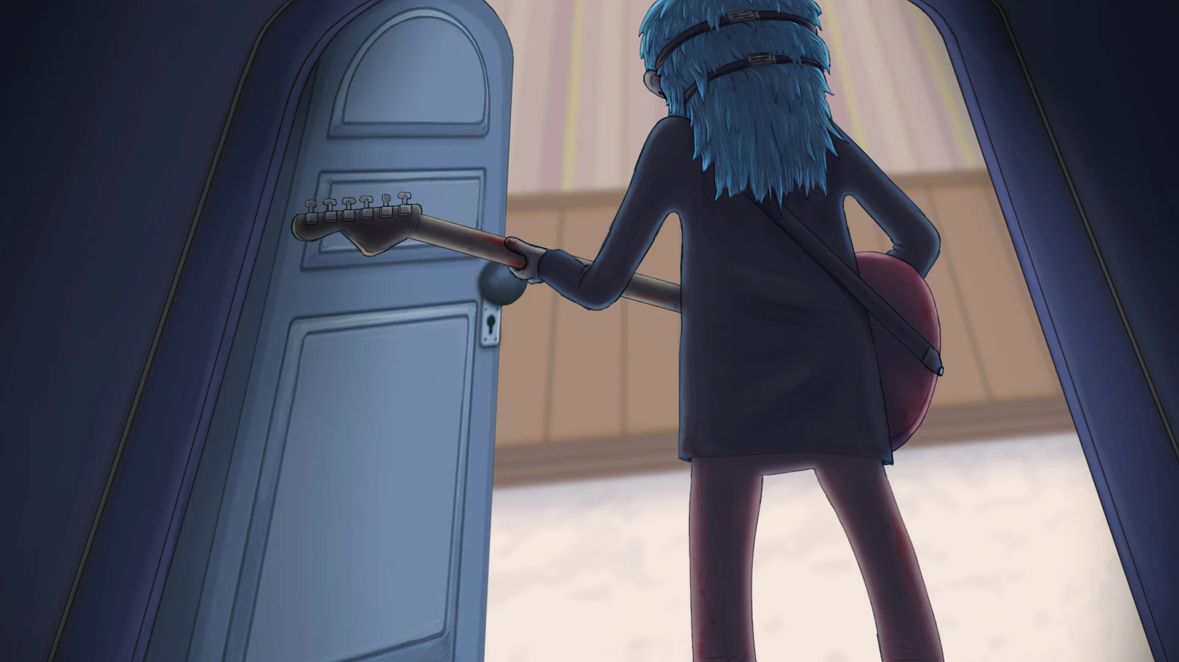
Project Health
“Healthy culture”
Hard line for problematic behaviour
Avoid exploitative behaviours
Anything at the expense of physical & mental health
Crunch
“sleep is for the weak” is a weird flex
Industry has similar issues!
Check out: http://lifetimeingames.com

Slide 6
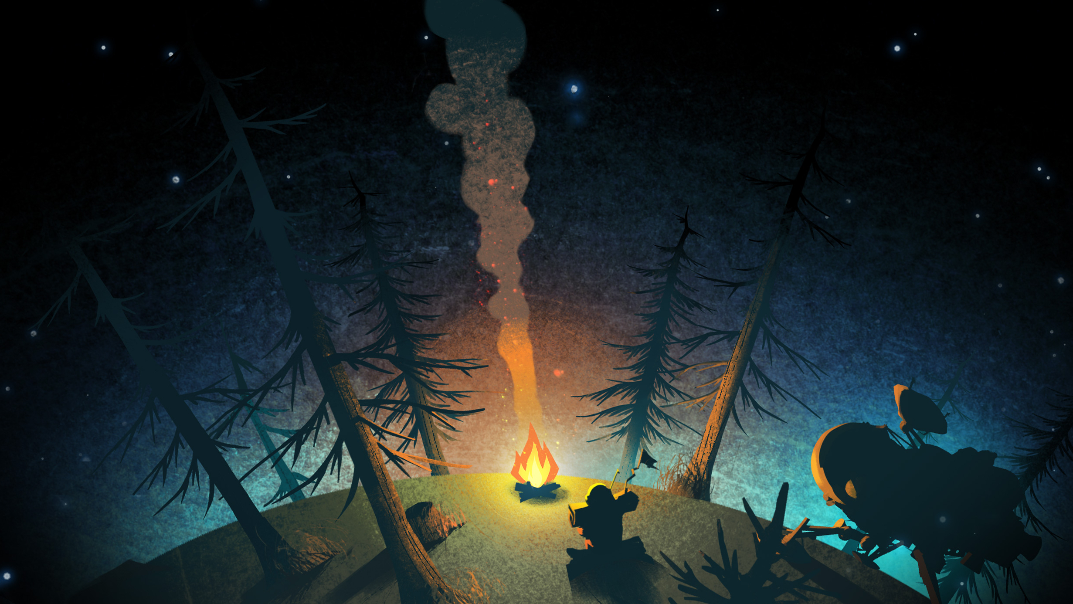
Project vision & concessions
Scope
What are the essentials?
Listen
Your idea is not the only (valid) idea
When stuck: take responsibility as a role
The team does not make YOUR project
Stick to the vision
Team solutions

Slide 7
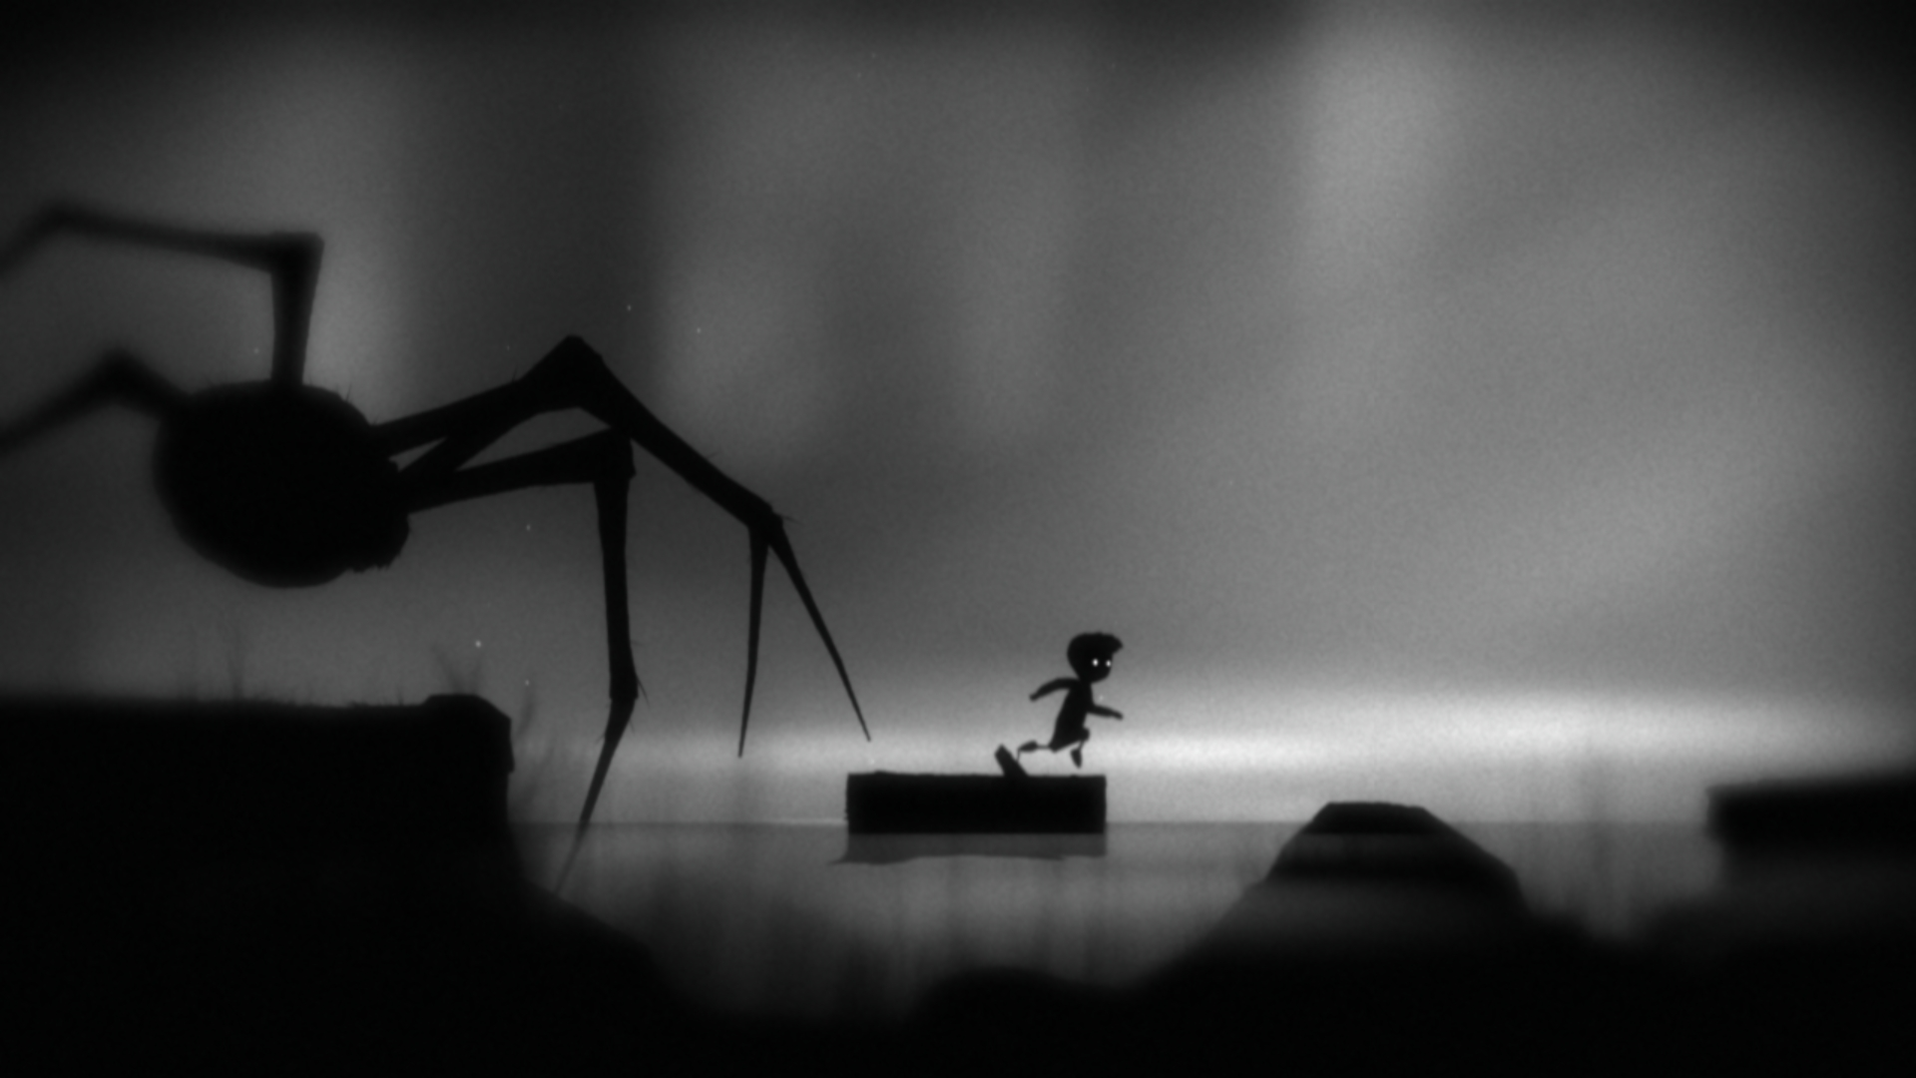
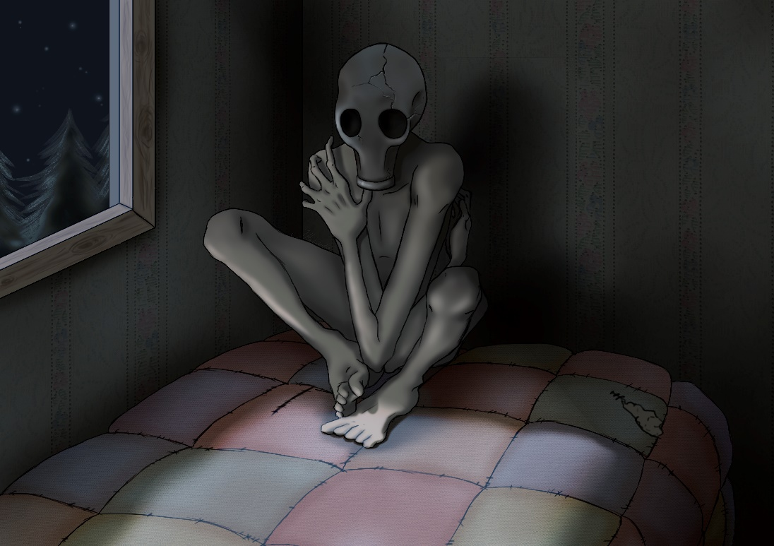
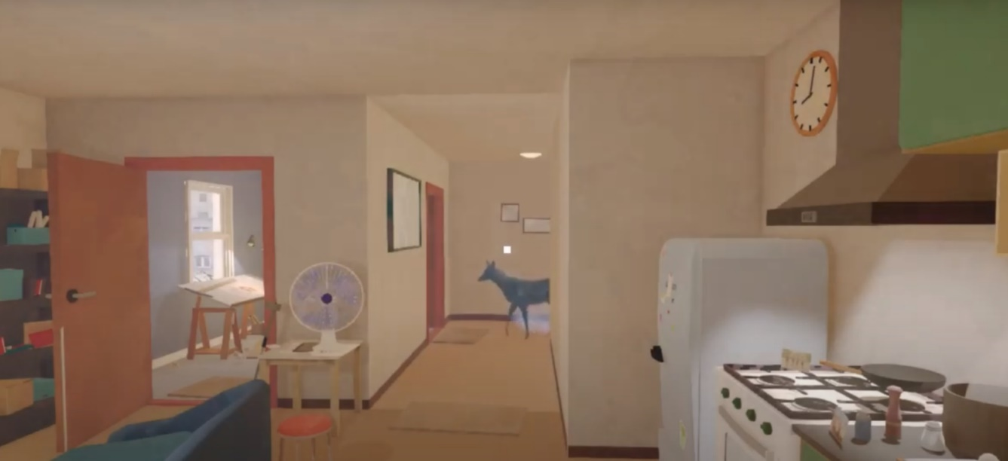
Project vision & concessions
Example: The Watcher

Slide 8
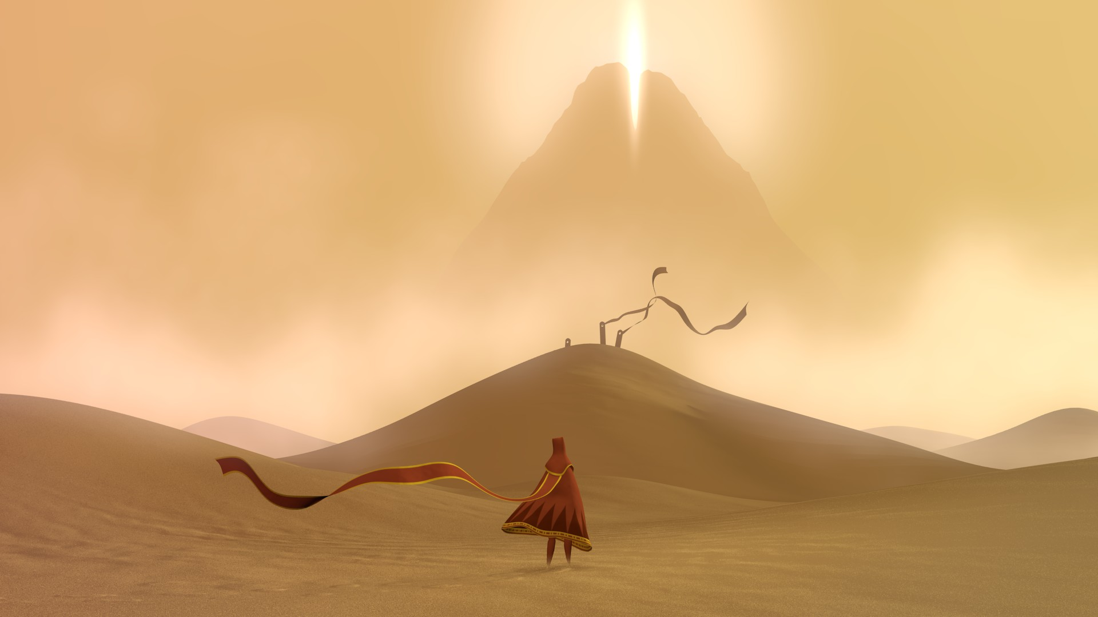
The art of feedback
Multiple ways
Most people aren’t good at it
Insecurity
“Your code is shit”
Bad feedback
Firestarter
Hamburger model
Positive remark
Point of improvement
Positive remark
Be specific!

Slide 9
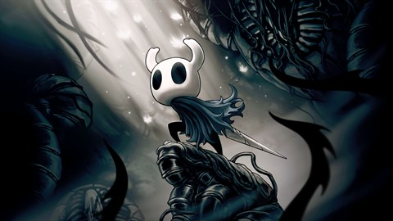
Conflict
Talk before action
One on one
Impartial overseer
Friends ≠ colleagues
Apologies are hard
Avoid certain topics

Slide 10
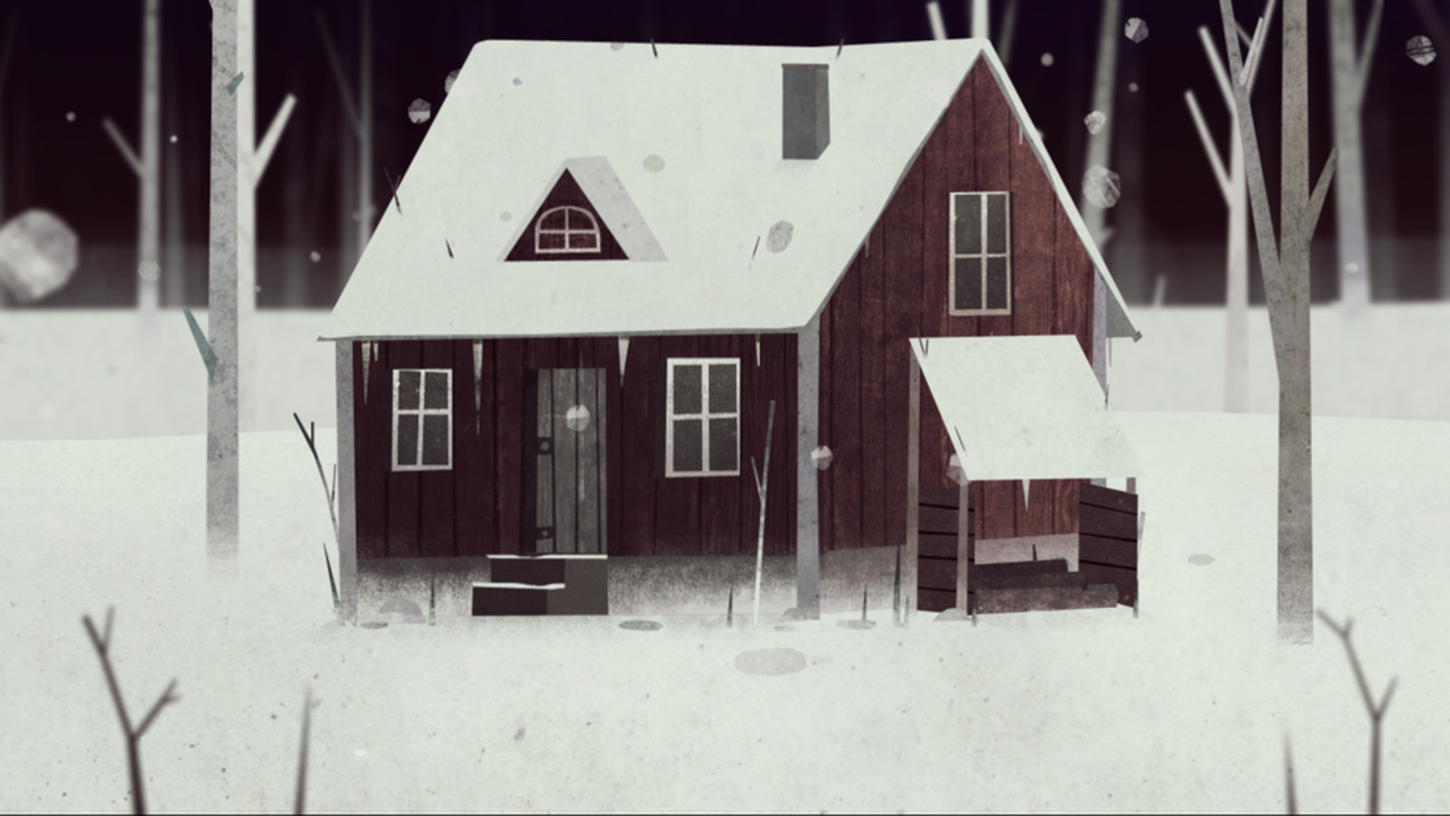
Conflict
Vision/Project
Consider your argument
Explain your point of view
Listen
Concessions
Personal
Explain your experience (“I”)
Listen
Try to come to mutual agreement
Involve student counsellor if need be
Involve the authorities (teachers)
Example

Slide 11
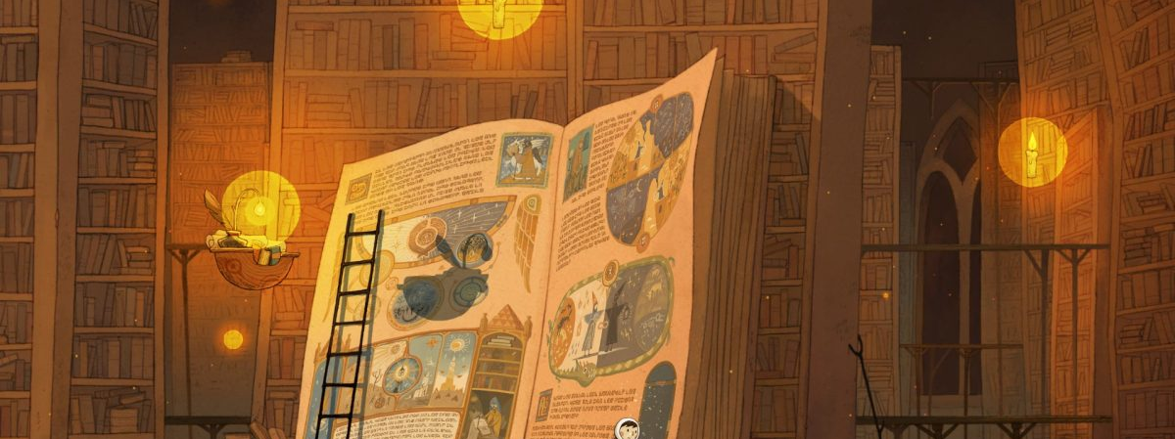
Meetings & Documents
Never double up
Only do what works
Let it go

Slide 12
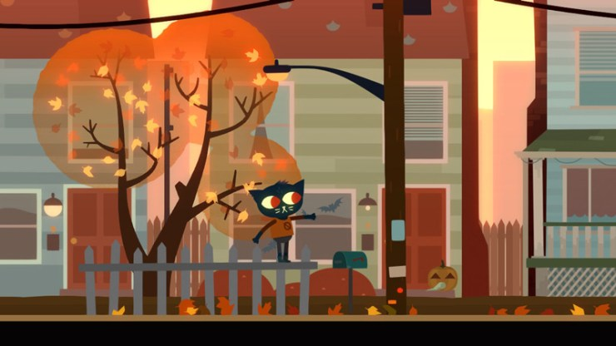
Meetings
Lead meet
Every day before 10
Only the leads
Stand-up
Every day at 10
Per department
Scrum
Every week on Tuesday
Department with dep lead and producer
Team meeting
Every week on Friday

Slide 13
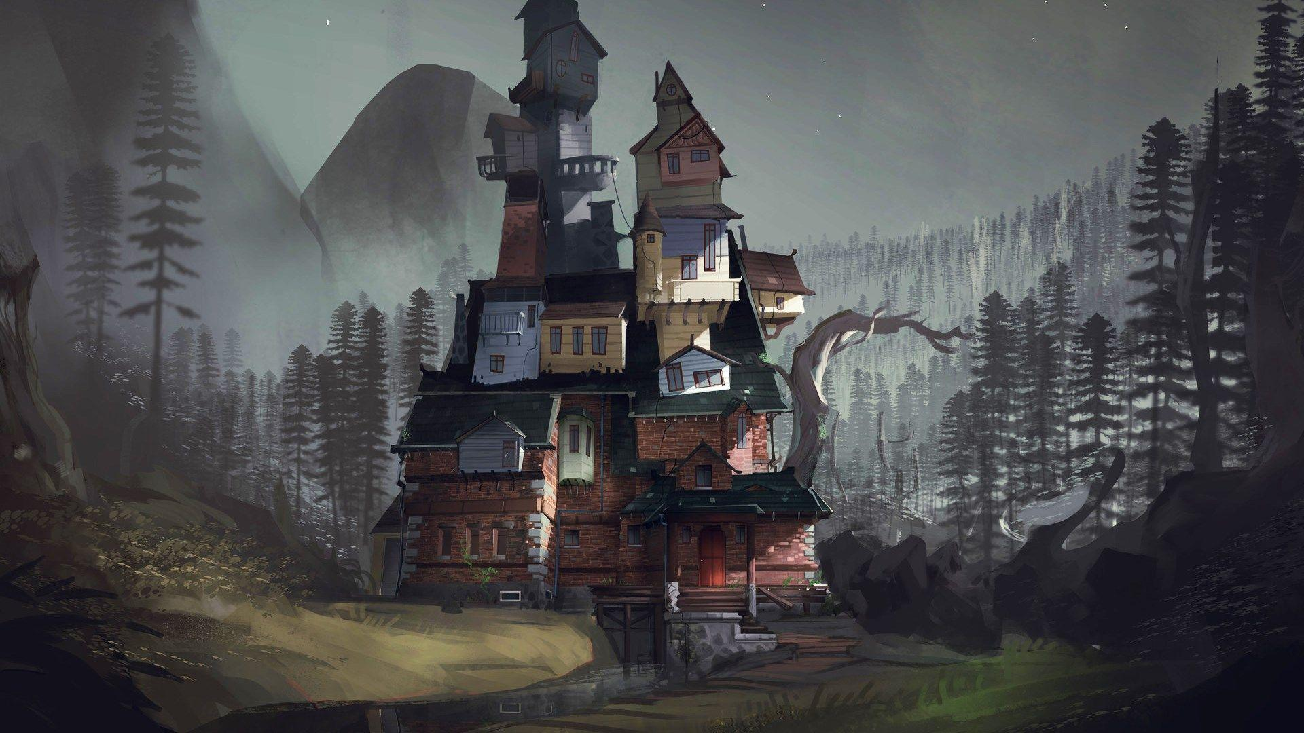
Documents
Communication plan
Tasks overview
Re-pitches
Missed working days/deadlines

Slide 14
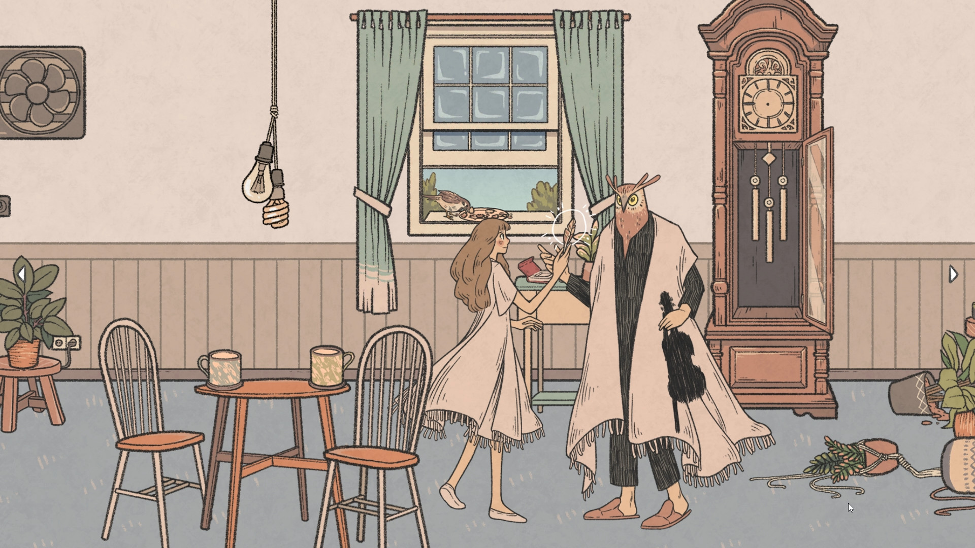
Documents
Weekly feedback form:
Workload
Personal progress
Positive trait in department lead
Negative trait in department lead
Fellow team members
Feedback producer
Feedback team lead
Personal problems
Schedule a meeting?
Additional feedback
Can the answers be shared?

Slide 15
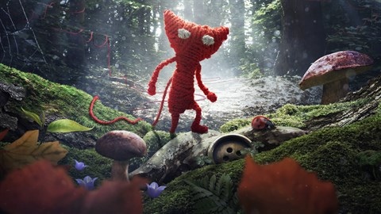
Take away
Communication can be difficult
Hard work
Valuable skill in more ways than one

Slide 16
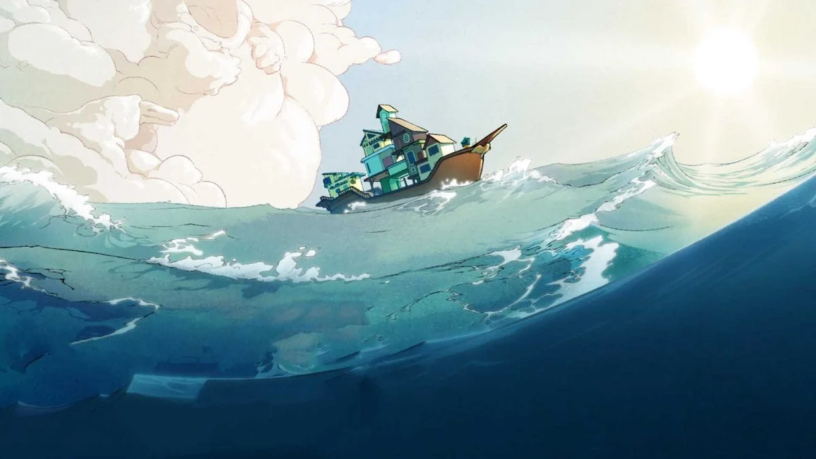
Thank you for your time
● Jitske Habekotté ● habekotte.j@buas.nl ●

Slide 17
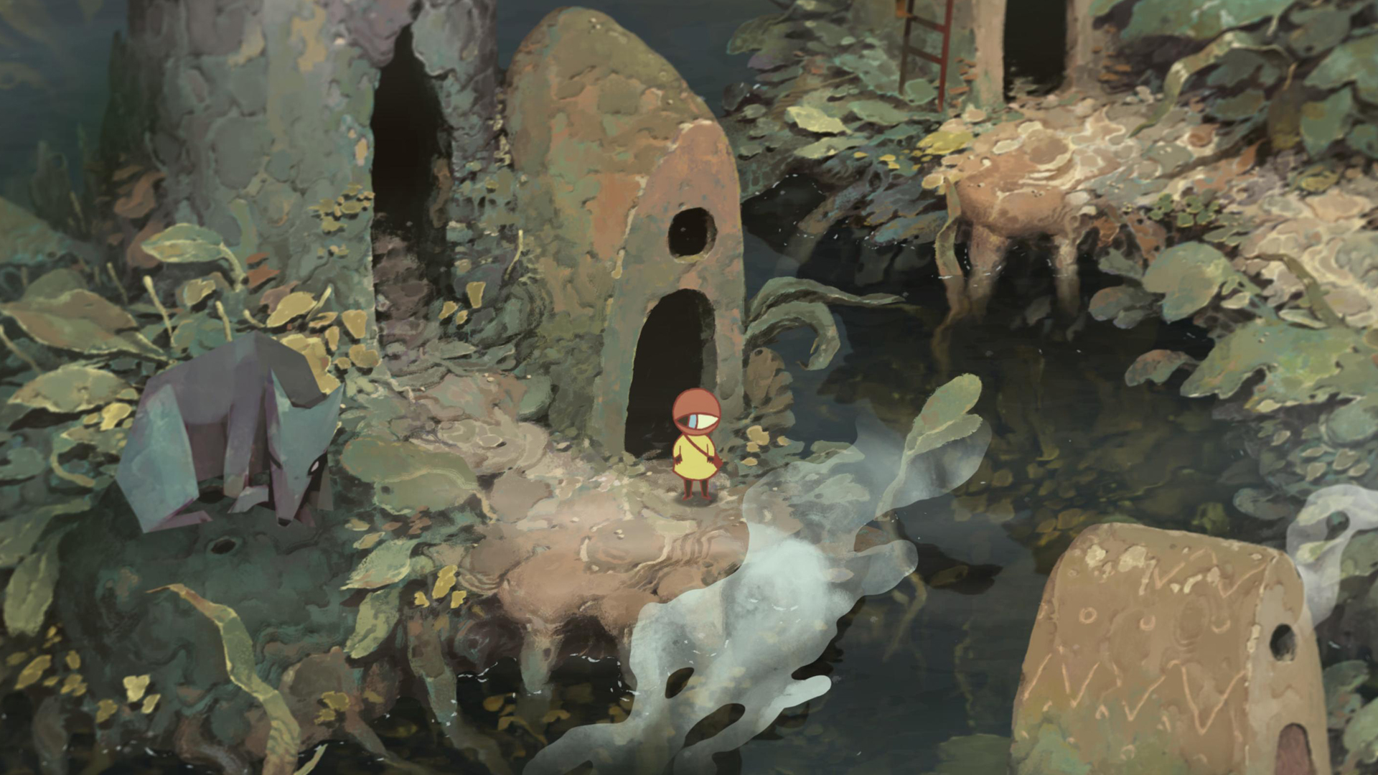
Questions?
● Jitske Habekotté ●
● habekotte.j@buas.nl ●

